Slide 1
The eastern seaboard
9 Days
Led by Pia Longinotti

Slide 2
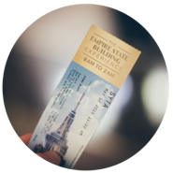
Our meeting will cover
Why Travel is Important
Our Tour
Our Travel Partner
What’s Included
and What’s Not
The Safety Approach
How to Reserve
Your Spot

Slide 3
Our adventure awaits

Slide 4
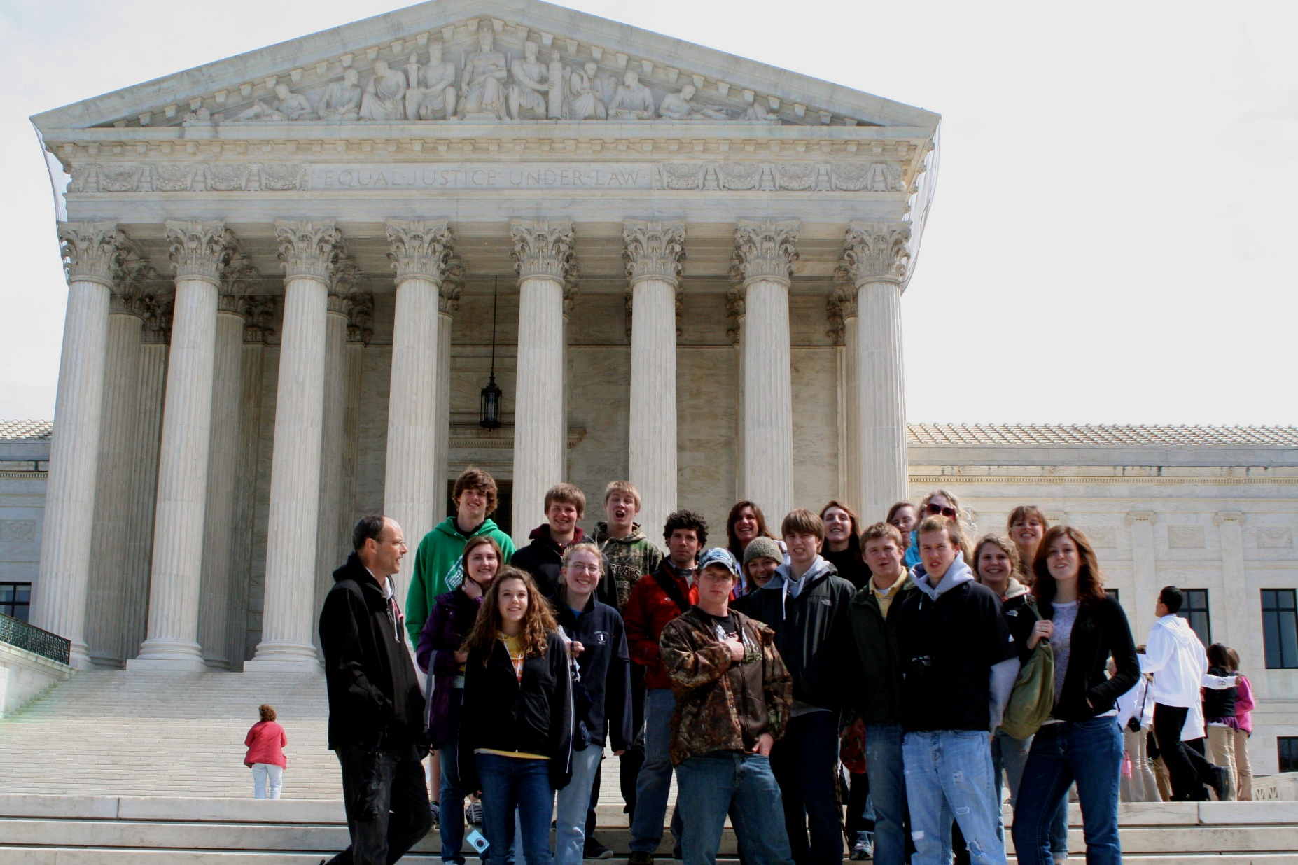
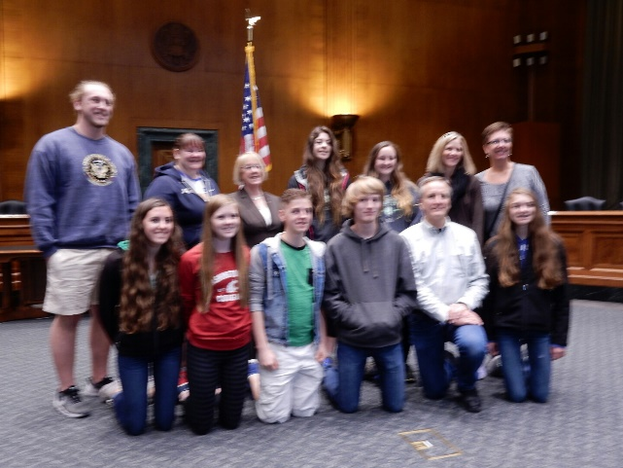
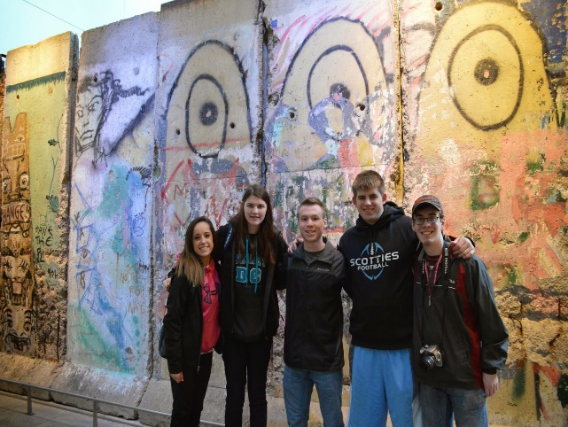
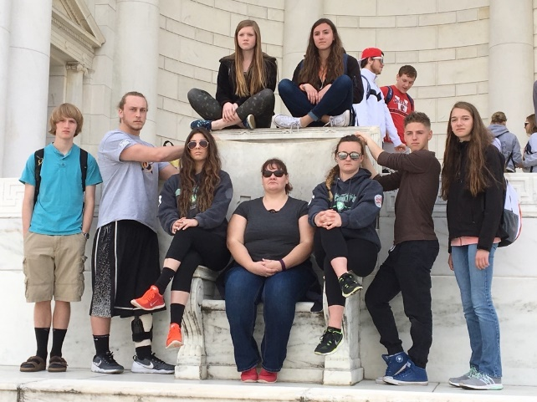
Tour highlights
Highlights from our itinerary
Walking Tour of Boston
9/11 Memorial
Holocaust Memorial Museum

Slide 5
EVERYTHING WE’LL SEE AND DO
THE EASTERN SEABOARD
Boston
Walking tour of Boston
Newbury Street
Public Garden
Boston Common
Beacon Hill
Public Library
Cheers
Boston Tea Party Ships and Museum
Dinner at Quincy Market
Guided sightseeing tour of Boston and Cambridge
Paul Revere House
USS Constitution
Old North Church
Bunker Hill
Freedom Trail
Harvard Square
Guided sightseeing tour of Lexington and Concord
Lexington Battle Green
Old North Bridge
Author’s Row
Orchard House or Old Manse
Guided tour of Midtown
Washington DC
Arlington National Cemetery, Changing of the Guard @ the Tomb of the Unknown Soldier, Kennedy gravesites
Smithsonian museums may include National Air and Space Museum, National Museum of Natural History, National Museum of American History
Night tour of Washington, D.C.
Mount Vernon: Mansion and grounds, museum and education center, and George Washington’s tomb
Marine Corps War Memorial
White House
Washington Monument
WWII Memorial
U.S. Supreme Court
Library of Congress
Capital Building
Lincoln Memorial
Korean War Veterans Memorial
Vietnam Veterans Memorial
Explore the Tidal Basin: FDR Memorial, and Martin Luther King, Jr. National Memorial, and the Jefferson Memorial
Washington DC Holocaust Memorial Museum
New York
Fifth Avenue
Rockefeller Center
St. Patrick's Cathedral
Bryant Park
Central Park
Empire State Building by night
Statue of Liberty
Ellis Island
9/11 Memorial and Museum
Times Square
Broadway show
Philidelphia
Walking tour of Independence National Historical Park
Congress Hall
Carpenters’ Hall
Franklin Court
Independence Hall
Liberty Bell Center

Slide 6
A more engaging learning experience
Help students become global citizens
Bring subjects and destinations to life
Develop perspectives that set students apart on college applications—and give them a leg up in their future careers
Spark the lifelong ability to take on any new experience with confidence

Slide 7
weShare enhances every tour
Personalized learning powered by your students’ curiosity
Before tour students connect their own interests and passions to your destination and develop an essential question to investigate while traveling.
On tour students continue to explore their questions and engage in more in-depth learning.
After tour students reflect through a creative project. This project is eligible for high school or college credit—and is a great asset for college applications.

Slide 8
Why EF?
Over 50 years of experience
Our 6th trip with EF!
Traveler Support Team
Educational value
Accredited, just like our school
Earn high school and college credit
Incredible travel experiences at the guaranteed lowest price

Slide 9
EF’s commitment to our safety
24/7 Tour Director
Chaperones
24-hour emergency on-call service
Professional overnight security dedicated specifically to our group
Travel ID badges and backpacks

Slide 10
Why group travel?
Group travel keeps tours affordable, allowing more students to see the world
Combined groups get the best value.
Meet other students from around the country.
Tour choice and departure date flexibility to match with other groups.
Our travel window is: Thursday, June 14, 2018 to Monday, June 18, 2018

Slide 11
Our travel window
Blocking off a travel window for your tour lets us book every aspect of your group’s itinerary—like flights, accommodations, site visits, and more—so that your travel experience is seamless and affordable.
Earliest potential
departure date
Latest potential
return date
Travel Window
Thursday
June 14, 2018
Tuesday
June 26, 2018

Slide 12
What are you responsible for?
Spending money
For free time activities, souvenirs, lunches and snacks.
Baggage fees
We highly recommend using a carry- on while traveling. Those checking a bag will be subject to airline fees.
Protection Plans

Slide 13
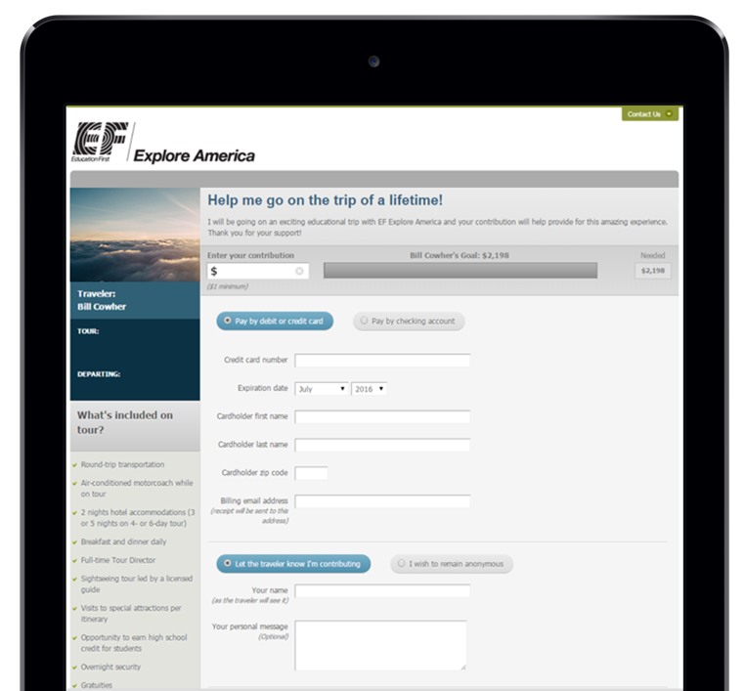
Your Giving Page
A quick and easy way to ask family or friends to contribute to your tour payments
How it works
Share your Giving Page (located on your personal EF website) on social media or via email with anyone you'd like to ask for donations
All contributions will be automatically applied to your balance

Slide 14
Protection Plans
*Maximum refund does not include your Protection Plan fees or any Non-Refundable fees. You can find all the details of both plans on pg. 20 of your Enrollment Guide.
Protect your investment against the unexpected. If you’re unable to go on tour for any reason, EF’s protection plans provide you with a maximum refund.*
Anytime Protection Plan
Basic Protection Plan
For protection up until the moment you leave and total peace of mind
Only $179 (added to overall tour cost)
Cancel for any reason
Cancel at any time
Maximum refund*
Rolls into your payment plan
Our base plan and essential trip protection
Only $129 (added to overall tour cost)
Cancel for any reason
Cancel up to 45 days before departure
Maximum refund*
Rolls into your payment plan

Slide 15
Payment options
1
2
3
Pay in full at enrollment (free)
Automatic Payment Plan (free)
Manual Payment Plan ($40 fee)
Pay the entire balance at the time you enroll
Payment methods accepted: Visa or MasterCard, ATM/debit card or personal checks
Make payments monthly on a preferred date or bi-weekly on a preferred weekday
Payments are automatically deducted from your bank account
Payment methods accepted: checking account, ATM/debit card or personal checks
Final payment extended up to one month before your tour
Receive invoices and make payments in less frequent installments
Payment methods accepted: Visa or MasterCard, ATM/debit card or personal checks
Accounts must have $350 total paid 30 days after enrollment
Final payment deadline is 110 days before your tour

Slide 16
Everything you get
Program price includes:
Round-trip airfare (+ Free travel day)
On-tour transportation
Safe, quality hotel rooms
Breakfast and dinner daily
Full-time Tour Director
Guided tours and activities
Professional overnight security
Travel gear
Traveler Support Team
Illness and Accident Coverage
24-hour emergency assistance
All gratuities
Giving page

Slide 17
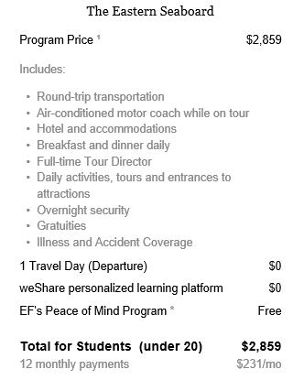
Paying for your tour
Educational travel at the guaranteed lowest price
You pay:
$231 a month
When you enroll
by 6/16/2017

Slide 18
Who’s in?
I’ll be enrolling students tonight. Spots are limited and available on a first-come, first-served basis. If you have questions, feel free to see me after our meeting.
Spots Available: 20
Enrollment window opens:
Right now!
Enrollment window closes:
Friday, June 16, 2017
Two easy ways:
Online
efexploreamerica.com/1844614SD
Phone
888-333-9756
To enroll you’ll need your tour number:
1844614SD
$50 OFF
WHEN YOU ENROLL BY
June 16th

